Slide 1


Technical Design Thinking II
Spring 2025
Teaming
Project Overview
Dr. Bruce McFall

Slide 2
Team Fundamentals
Definition of a Team
A team is a small group of people with complementary skills who are committed to a common purpose, performance goals, and approach for which they hold themselves mutually accountable

Slide 3
Teaming Objectives
Define key characteristics of a team
Identify stages of team development
Define a model for team effectiveness
Identify specific strategies for solving team problems

Slide 4
Keys to Building an Effective Team
Interdependence
Goal Specification
Cohesiveness
Communication

Slide 5
Effective Teamwork Involves…
Development of a Code of Cooperation
Includes checks for understanding to make sure everybody is “on the same page”
Requires effective listening skills
Requires the ability to give and take effective constructive feedback

Slide 6
Code of Cooperation
The agreed upon rules governing the behavior of team members, as well as any appropriate rewards and sanctions
It sets a norm for acceptable behavior for each team member and represents how the team members will interact with one another
It should be developed, adopted, improved and/or modified by all team members on a continuous basis
It should be easily accessible to team members – bring a copy to meetings
Has two types of “rules”
Individual behavior – The team expectation of each member’s individual behavior/contribution to the team
Overall Team behavior – Everyone's expectation of team behavior/contribution

Slide 7
Code of Cooperation (Boeing)
Only one person speaks at a time
Everyone participates, no one dominates
Be succinct, avoid long anecdotes and examples
Be an active listener
No rank in the room
Maintain confidentially
What is said stays in the team room
Minutes, results, reports, etc. are shared with appropriate individuals
Ask questions when you do not understand
Attend to your personal comfort needs at any time, but minimize team disruption
HAVE FUN !!!
EVERY member is responsible for the team’s progress and success
Attend all team meetings and be on time
Come prepared
Carry out assignments on schedule
Listen to and show respect for the contributions of other members
CONSTRUCTIVELY criticize ideas, not persons
Resolve conflicts constructively
Pay attention, avoid disruptive behavior
Avoid disruptive side conversations

Slide 8
Other Important Issues
Individual Team Building Skills
Build on each other’s comments and ideas
“Susan, that’s a good idea. I was also thinking about a design alternative similar to …. What do you think?”
Ask questions for clarification
“Noah, what do you mean by …? I’m a bit confused…”
Ask for justification, data, and evidence
“I also feel that a grinder is a good alternative, but what evidence do we have to claim that this is a better alternative than the roller design? I’d be really interested in hearing your findings”

Slide 9
Other Important Issues
Constructive Feedback
Communication to a person (or group) regarding the effect that a person's behavior has on another person or on the group
Perceptions, feelings, and reactions to the message
Give Receive
Be descriptive Listen carefully
Don't use labels Ask questions for clarity
Don’t exaggerate Acknowledge the feedback
Don’t be judgmental Acknowledge the valid points
Speak for yourself Think about what you heard

Slide 10
Other Important Issues
Constructive Feedback should include Phrases like:
When you… – describe the behavior without judgment, exaggeration, labeling, attribution, or motives
Just state the facts as specifically as possible
I feel… – tell how their behavior affects you
If you need more than a word or two to describe the feeling, it’s probably just some variation of joy, sorrow, anger, or fear.
Because I … – say why you are affected that way
Describe the connection between the facts you observed and the feelings they provoke in you

Slide 11
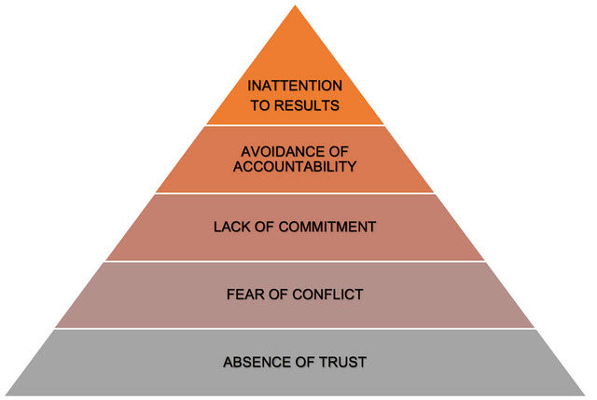
Dysfunctional Team Issues

Slide 12
What is ahead of your Team on the Project
Stages of a Technical Design Process
The design process is a series of steps that team members follow to come up with solutions to problems. This structured approach ensures efficiency and effectiveness in the development of products and/or systems

Slide 13
Stages of a Technical Design Process
Problem Identification
The first stage involves clearly defining the problem. Team members must understand what needs to be solved and why it is important. The success of a project often hinges on how well this stage is conducted
Requirements and Specifications
Once the problem is identified, team members conduct research to gather relevant information and resources. They consider existing solutions, and constraints, and specify the requirements for the project combining this knowledge into a set of specifications that guide the subsequent stages

Slide 14
Stages of a Technical Design Process
Conceptual Design
Team members then generate a range of ideas and possible solutions. This stage involves creative thinking and the application of scientific principles to develop conceptual models. Each concept is evaluated against the project requirements
Preliminary Design
In this phase, the most promising concepts are developed into more detailed preliminary designs. Initial models and prototypes may be created to explore these concepts further
Detailed Design
The detailed design phase is where a final solution is developed in depth. Team members define exact specifications, create detailed drawings, and plan the manufacturing process. This documentation is crucial for the next stages

Slide 15
Stages of a Technical Design Process
Testing and Evaluation
Prototypes and models undergo rigorous testing to ensure they meet all criteria and function as intended. Evaluation is based on performance, safety, and compliance with regulations
Iteration
Finally, based on feedback from testing and evaluation, team members may return to previous stages to refine the design. This process of iteration continues until the solution meets all the specifications and requirements satisfactorily

Slide 16
Stages of a Technical Design Process
Documentation and Communication
Effective documentation and communication are paramount in the design process. They facilitate clear understanding and collaboration among stakeholders, ensuring that design intentions are accurately conveyed and recorded.

Slide 17
Stages of a Technical Design Process
Design Documentation
Captures the various aspects of the technical design in a structured format. This typically includes:
Technical Drawings: Precise drawings/flowcharts that represent the design, often including dimensions and specifications
Specifications: Detailed descriptions of the materials, components, and systems used
Project Timelines: Schedules that outline major milestones and deadlines for the project
Test Results: Data and analysis from testing phases to validate design performance
Change Logs: Records of any alterations made to the original design along with rationales for each change

Slide 18
Stages of a Technical Design Process
Communication of Design Solutions
Communication of design solutions is about effectively sharing the design intent and specifics with all parties involved. Key methods include:
Presentations: Formal meetings where design details are presented through slides or demonstrations
Reports: Written documents that report on the design's progress, challenges, and successes
Meetings and Discussions: Regularly scheduled or ad-hoc discussions to facilitate real-time exchange of ideas and feedback
Email and Memos: Written correspondence for quick updates or decisions that need to be communicated promptly
Clear and timely communication ensures that everyone involved in the project from team members to stakeholders remain informed and engaged throughout the design process

Slide 19
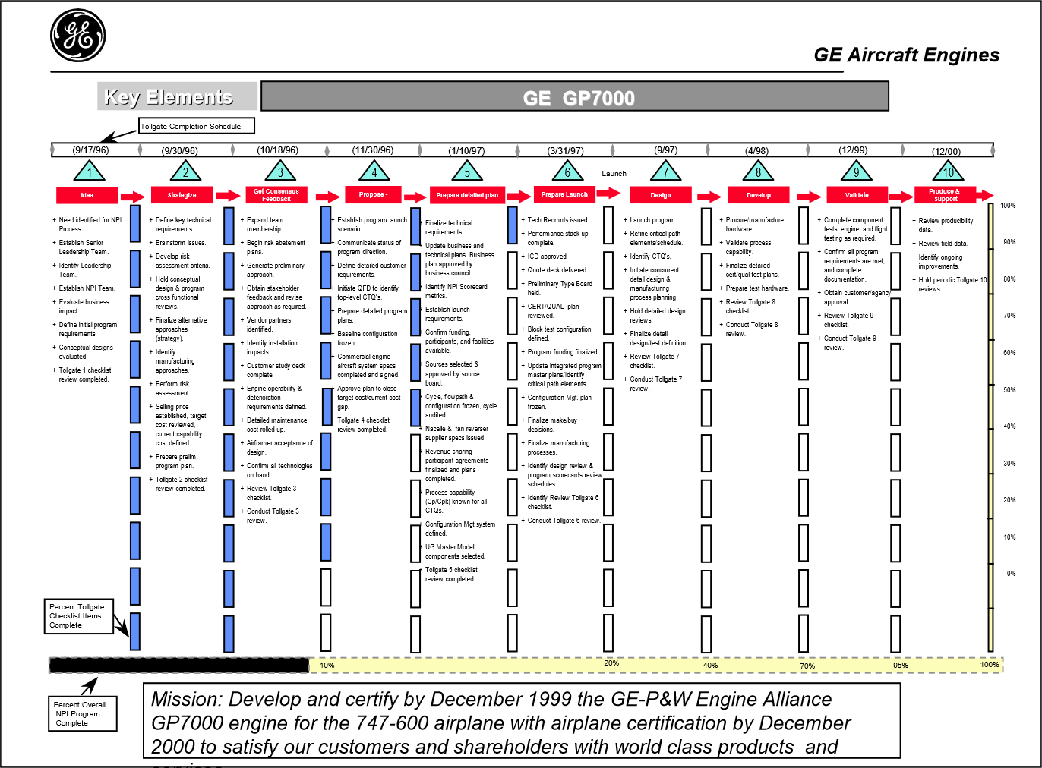
Design & Systems Thinking – NPI Process
Program Name
Mission Statement

Slide 20
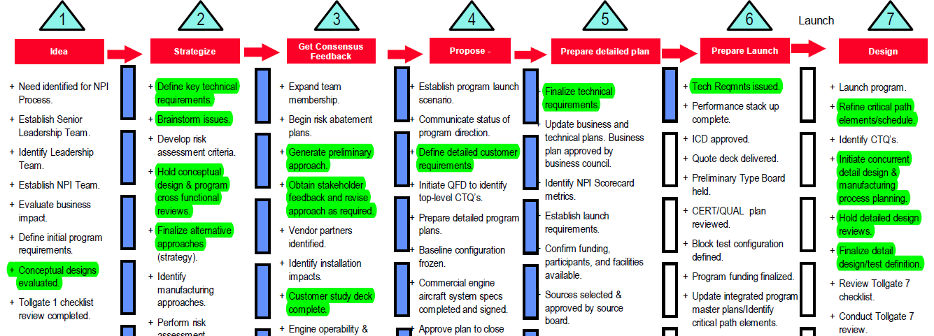
Design & Systems Thinking – NPI Process
Think a lot, then start doing…

